Slide 1
xDAC v3
09/02/2026

Slide 2
Issues
RF amplifier bias.
op-amps gain (polarization controller).
SPI - SDI and SDO lines.
Short circuit I/O expander.
TEC PID Control (Resistor Adjustment) .
TEC controller bias.
UART–EDFA Digital signal levels.
Select input C - demultiplexer.
Note 1: Even though all the issues have been identified and fixed in the schematics, the PCB layout has yet to be modified.
Note 2: All these issues have been logged in Redmine under Bug #163
Note 3: The xDAC3 Altium files are in here: xDAC carrier V3

Slide 3
Improvements
Power supply. Not implemented but under test.
Will the following circuits be implemented in the xDAC?
Voltage suppression detection. Not implemented but under test.
PD circuit for measure the injection locking signal, Not implemented but under test

Slide 4
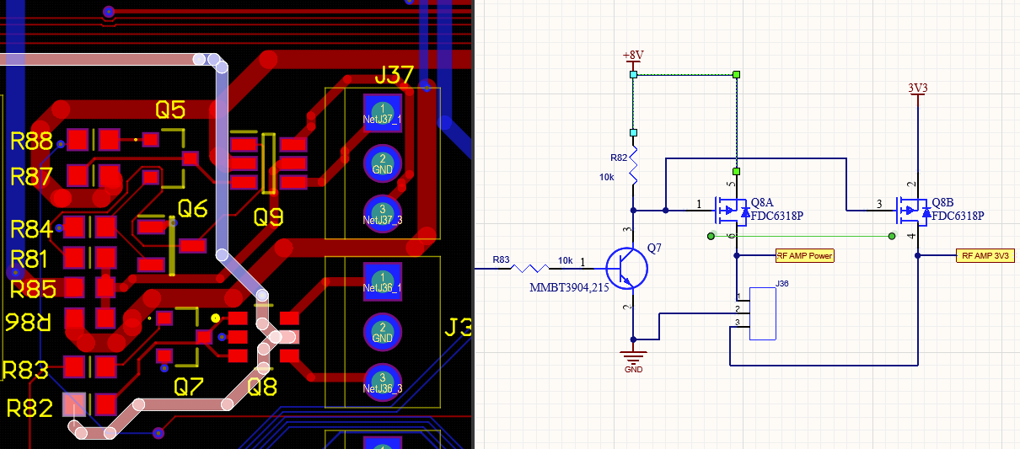
Summary of Issues:
RF Amplifier Bias
Change the 8V rail to 12V. The RF amplifier requires a voltage higher than 9V, so 8V is not sufficient to bias it.

Slide 5
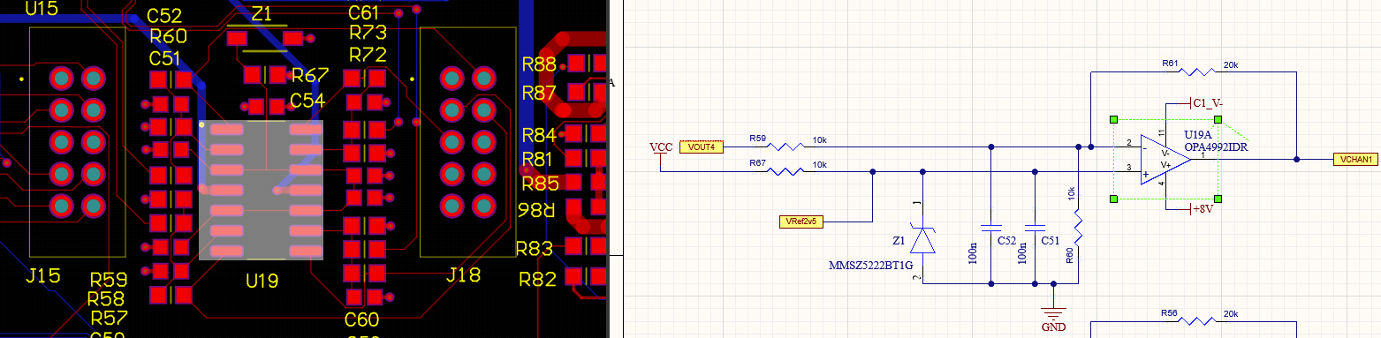
Op-Amp Gain (Polarization Controller)
R60, R58, R71, and R72 must be removed as they are causing incorrect performance in the OPAMP configuration.
R61, R56, R69, and R74 should be replaced with 30K resistors.
Current design

Slide 6
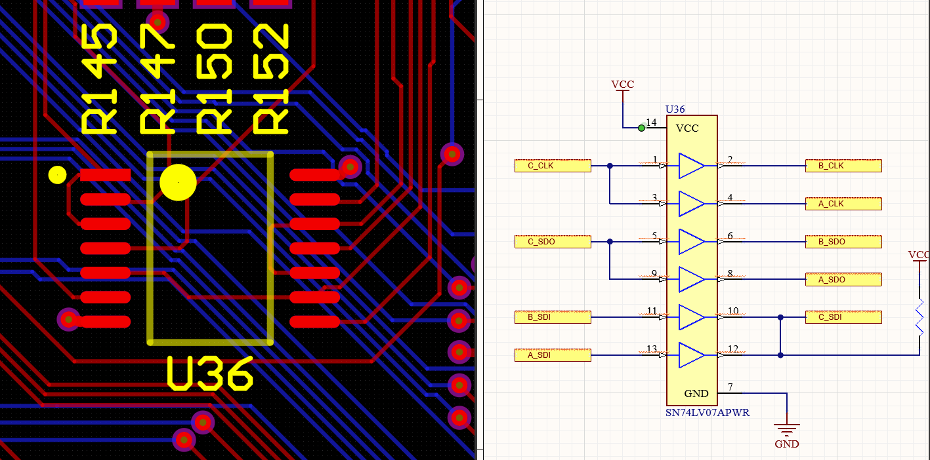
SPI - SDI and SDO lines.
The IC U36 (SN74LV07APWR, buffer) does not allow successful data flow on the SDI and SDO lines. The buffer is unidirectional.​ This issue only affects the iDACs, meaning that other devices connected to the SPI interface function properly.
C_SDO should have been connected to the output pin instead of the input pin. Similarly, C_SDI should have been connected to the input pin instead of the output pin. R

Slide 7
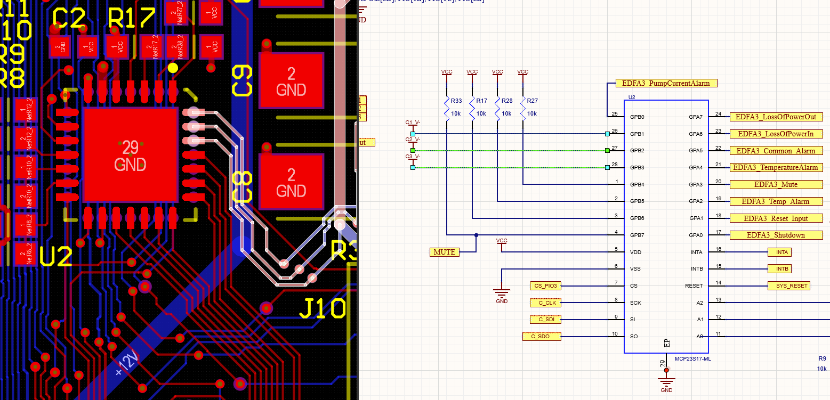
I/O Expander — Short-Circuit
The inputs GPB1 (pin 26), GPB2 (pin 27), and GPB3 (pin 28) on the IC U2 (MCP23S17) must be disconnected from the signals C1_V-, C2_V-, and C3_V-. These signals carry negative voltages, causing a short circuit on the PCB.
These inputs should instead be connected to VCC using pull-up resistors.

Slide 8
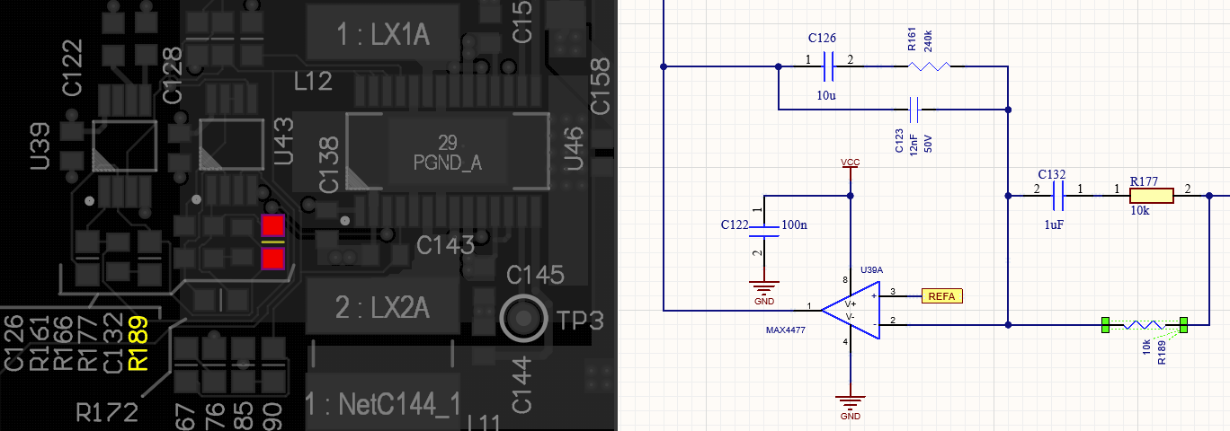
TEC PID Control (Resistor Adjustment) .
R189, R186, and R170 should be replaced with 510K resistors. These resistors are part of the differential network PID and set the derivative gain.

Slide 9
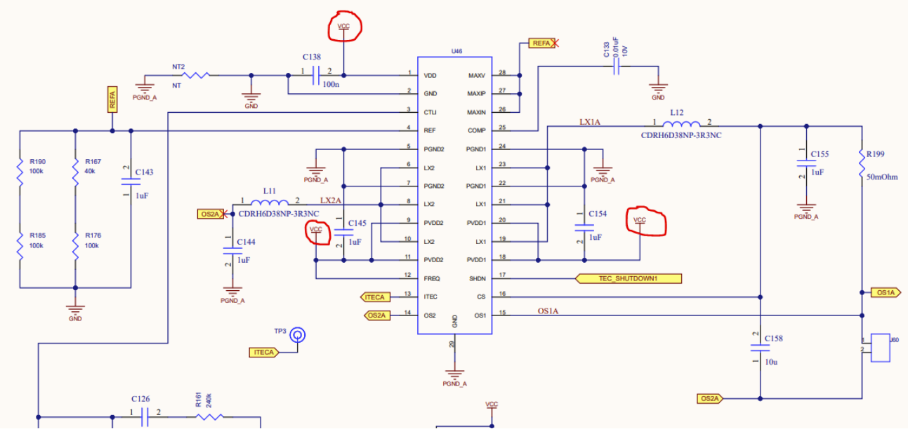
TEC controller bias.
Modify the TEC bias connection to the VCC-TEC rail in the ICs U46, U45 and U47. In the current design, the TEC bias is connected to VCC, which is introducing a 1 MHz noise in the VCC rail. This noise corresponds to the internal frequency of the TEC.

Slide 10
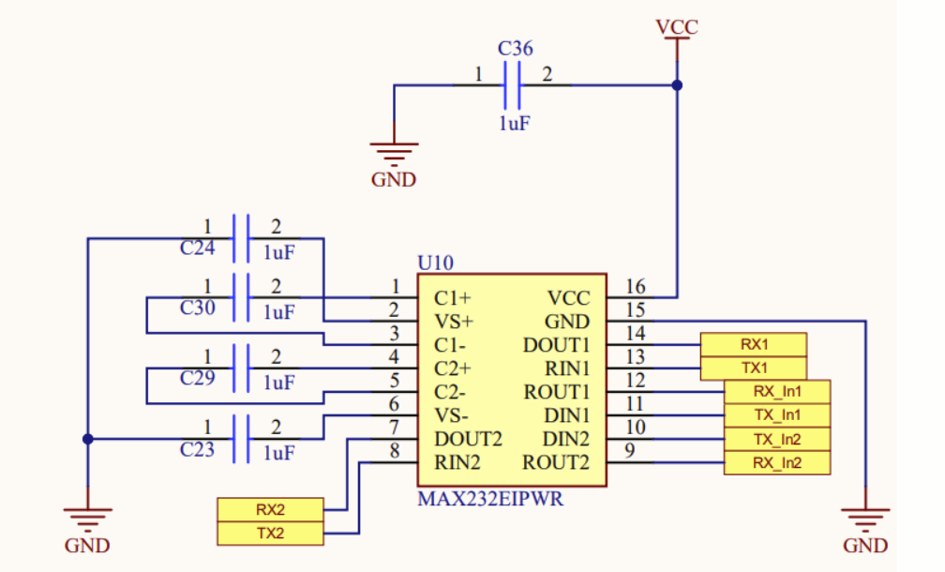
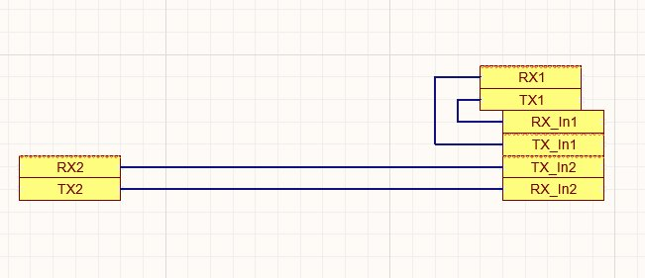
UART–EDFA Digital signal levels
The MAX232 (U10) must be removed, as the EDFAs operate with TTL and LVTTL signal levels.
The solution that was implemented is shown in the image. Some cables were soldered to complete the path between the EDFAs and the Raspberry Pi.
Example - New design

Slide 11
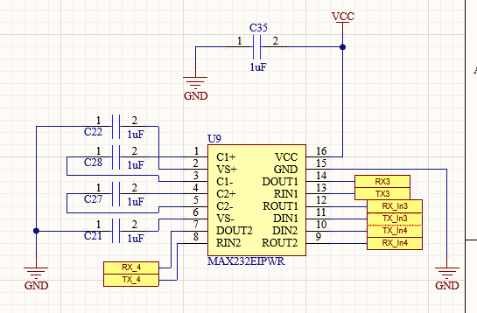
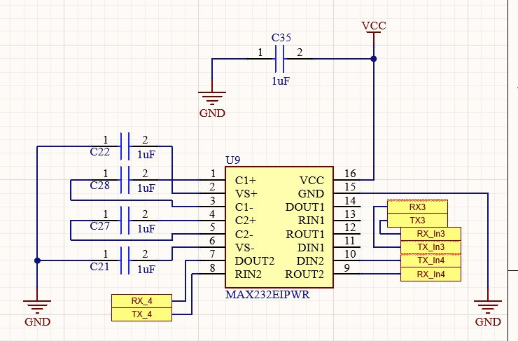
The 3th EDFA shares the MAX232 with the optical filter. Since the optical filter requires the MAX232 interface, U9 cannot be removed, so the EDFA RX and TX lines must be rerouted.
Example - New design

Slide 12
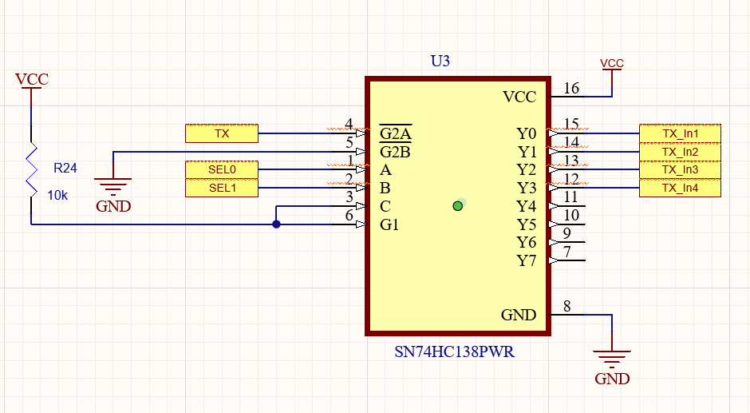
Select input C - demultiplexer
The selection pin C is misrouted. This pin must be connected to ground to correctly select the output.

Slide 13
Summary of Improvements:
ADC and DAC design
PD circuit for measure the injection locking signal.
Voltage suppression detection.

